Slide 1
Collective expulsion and police violence along the Balkan Route (Slovenia)
Infokolpa, Jošt Žagar

Slide 2
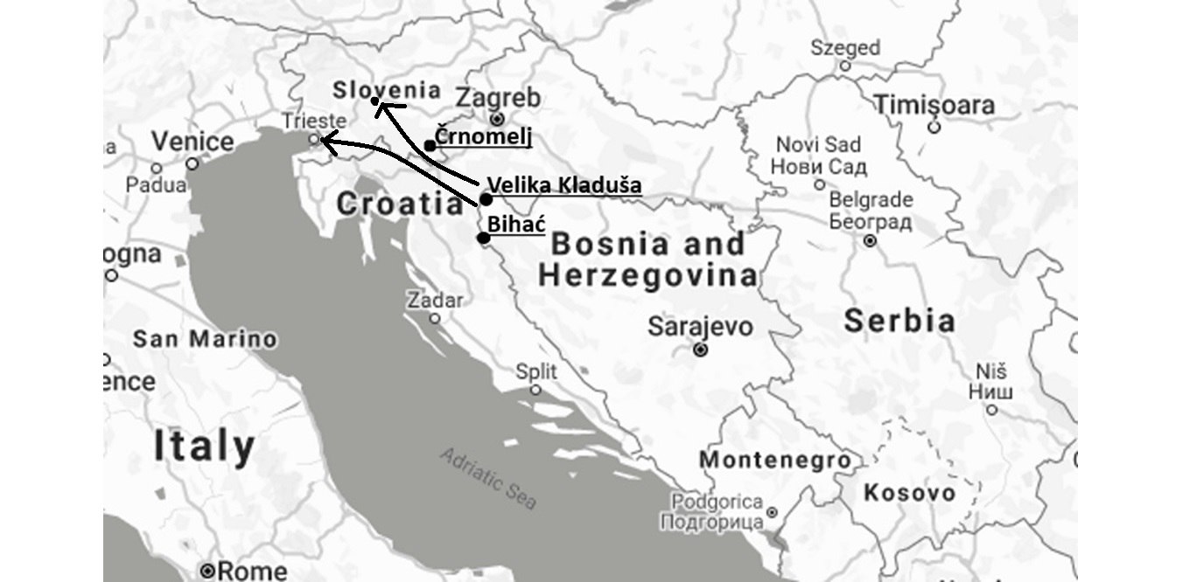

Slide 3
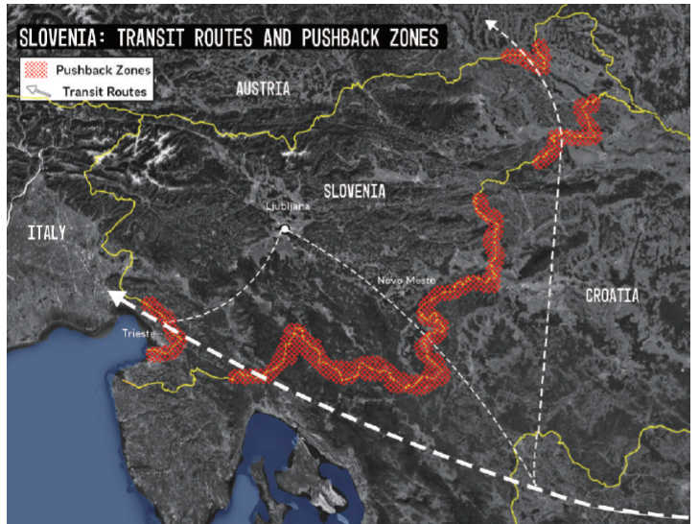

Slide 4
Video footage of pushback practice (Cro-BiH border near Lohovo (BiH), 29.9-10.10.2018):
https://www.borderviolence.eu/wp-content/uploads/bvm_4_klein.mp4?_=1
Collective pushback by readmission from Ilirska Bistrica (19th of July 2019):
https://siol.net/novice/slovenija/policija-o-ravnanju-z-migranti-pri-ilirski-bistrici-postopki-so-bili-zakoniti-in-strokovni-503052

Slide 5
Number of recorded intentions to seek asylum on police station Črnomelj (southern border)

Slide 6
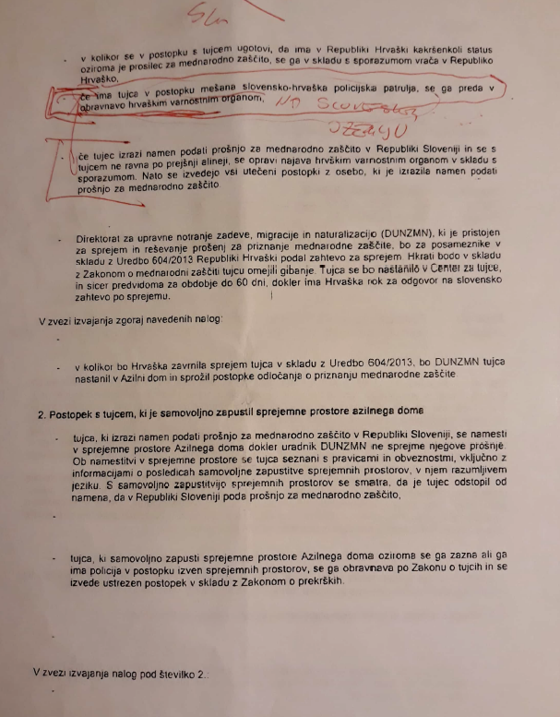
Directives of General Director of Police on police procedures on the boder (25th of May 2018)
https://push-forward.org/porocilo/objava-internih-policijskih-navodil-za-ravnanje-z-migranti-release-internal-police

Slide 7
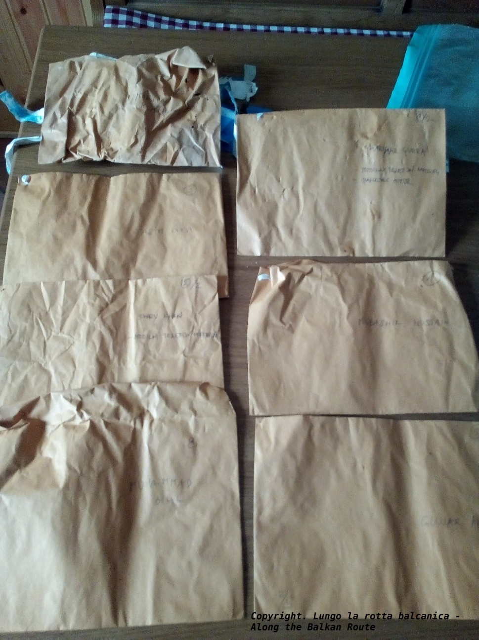
Envelopes and wristbands used in readmission from Slovenia to Croatia were found on Croatian-Bosnian border near Bihać (photo: Lungo la rotta balcanica, 2018)

Slide 8
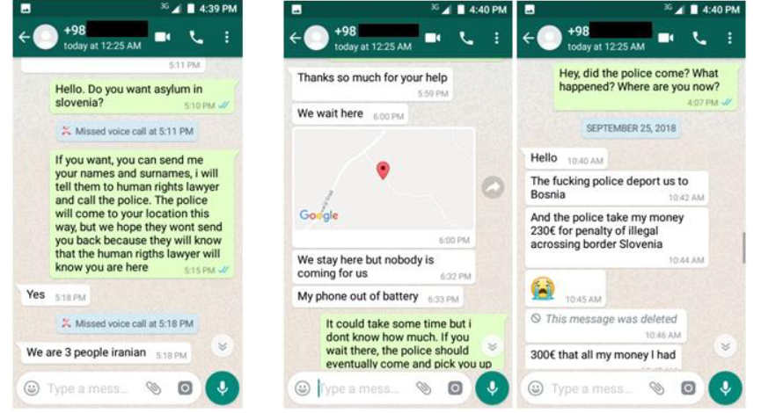

Slide 9
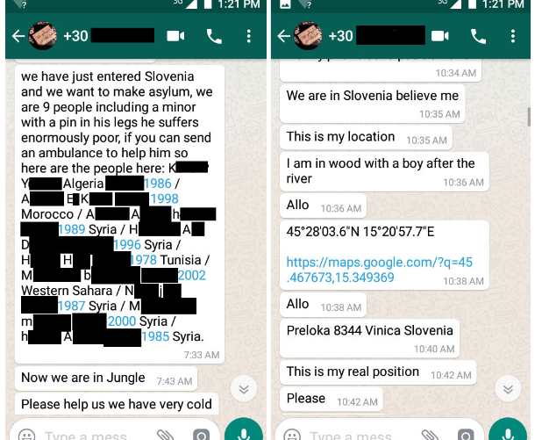

Slide 10
Results of the phone operation (1. 9. to 7. 11. 2018)
20 interventions (106 people)
6 groups (39 people) were accepted forward to asylum procedure
6 groups (27 people) were pushed backed to Bosnia and Herzegovina
7 groups (39 people) were not heard from again (possibly due to destroyed phones or no desire to continue communication)
1 person was accepted into asylum procedure in Croatia after the readmission
Full report: https://push-forward.org/porocilo/report-illegal-practice-collective-expulsion-slovene-croatian-border

Slide 11
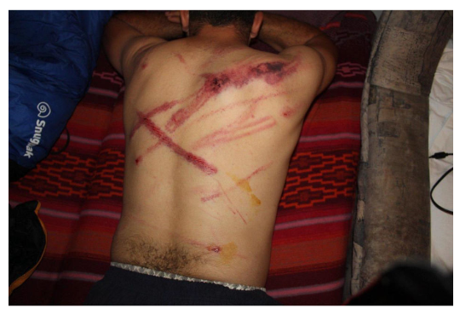
On 27th of July 2018 the person on the picture was beaten after readmission from Slovenia when being expulsed to Bosnia and Herzegovina.
https://www.borderviolence.eu/violence-reports/july-29-2018-1400-croatian-border-with-bosnia-nearby-the-official-check-point-in-velika-kladusa/
On 3rd of March 2020 a group of 32 people (including 12 children and a pregnant woman) were found on different train-cars transporting clay. After initial procedure all were readmitted to Croatia and pushed back to Serbia.
https://www.borderviolence.eu/violence-reports/march-3-2020-0000-harmica-croazia/

Slide 12
Number of recoded irregular border crossings and number readmissions by year
 | Irregular border crossings | Readmissions (from Slovenia to Croatia)
2018 | 9.149 | 4.653
2019 | 16.099 | 11.026
2020 | 16.252 | 9.950
https://www.policija.si/o-slovenski-policiji/statistika/mejna-problematika/nedovoljene-migracije-na-obmocju-republike-slovenije

Slide 13
Chain pushbacks from Italy and Austria
 | Readmissions from Italy to Slovenia | Readmission from Austria to Slovenia
2018 | 351 | 37
2019 | 255 | 81
2020 | 1.116 | 176
https://www.policija.si/o-slovenski-policiji/statistika/mejna-problematika/nedovoljene-migracije-na-obmocju-republike-slovenije

Slide 14
EU and Border Externalization (Slo and Cro)
Slovenia (October 2019) – 2014-2020 (Allocated)
ASYLUM, MIGRATION AND INTEGRATION FUND (AMIF): 20,63 million EUR
INTERNAL SECURITY FUND (ISF): 51,71 million EUR
Croatia (January 2020) – 2014-2020 (Allocated)
ASYLUM, MIGRATION AND INTEGRATION FUND (AMIF): 28,16 million EUR
INTERNAL SECURITY FUND (ISF): 87,09 million EUR

Slide 15
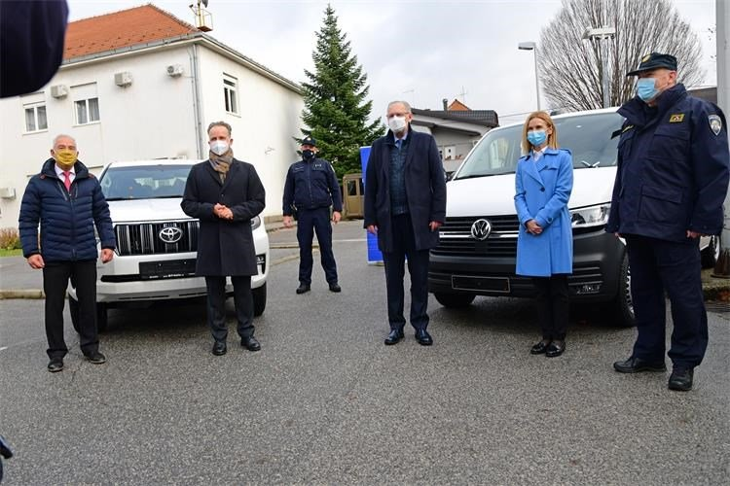
“Germany donates vehicles for Croatian border police worth €835,000„ – 11.12.2020
https://www.croatiaweek.com/germany-donates-vehicles-for-croatian-border-police-worth-e835000/

Slide 16
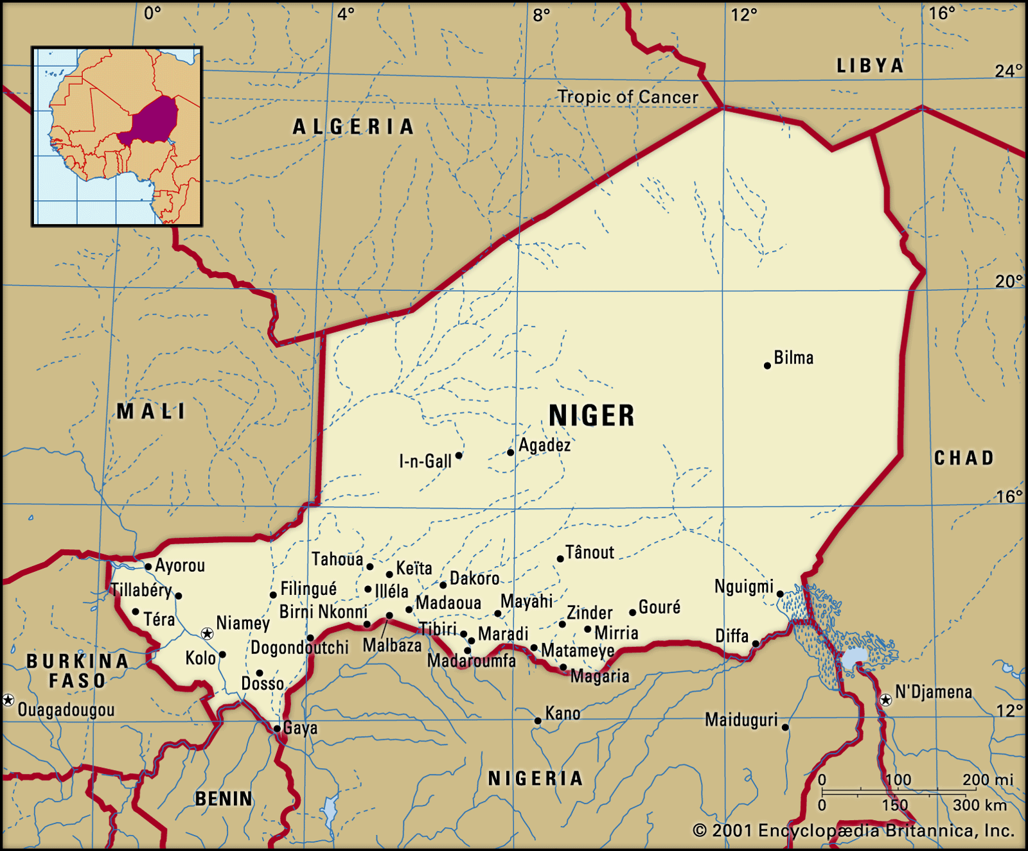
Closure of Sahara and Mediterranean Route (2015-2017)
Case of Niger
Criminalization of transport across Sahara (2015)
Donation by Germany of 10 million in equipment (trucks, vehicles, satellite telephones)
 | Number of recorded crossings (Dirkou – Lybia border) | Number of recorded deaths in attempted crossing of Sahara desert
2016 | 290.000 | 95
2017 | 33.00 | 427

Slide 17
Case of Libya and establishment of SAR (Search and Rescue zones)
October 2014 – removal of Italian ships from rescue operations (Mare Nostrum)
Active support to militias in Libya to preform the role of “coast guard”- “EU and Italy put aside €285m to boost Libyan coast guard”, 29.11.2017, https://euobserver.com/migration/140067
 | 2015 | 2016 | 2017 | 2018 | 2019 | 2020
Arrivals to Italy | 153 842 | 181 436 | 119 369 | 23 370 | 11 471 | 34 154

Slide 18
Case of Sudan and Rapid Support Forces
6. April 2016 - EU commissioner Neven Mimca visits Sudan (Better Migration Managment – 40 million EUR support to border managment)
RSF – formed from milita (janjawid) involved Darfur genocide, shooting and killing of 100 protesters during a crackdown on Sudanese revolution
Humanitarian assistance as practice of border imperialism
Valletta Summit, 11.-12. November 2015
EU Emergency Trust Fund for Africa (financial instrument to support border management operations: police units, vehicles, communications and surveillance equipment, bio screening, etc.)

Slide 19
Further information
Balkan Route:
https://push-forward.org/
https://www.facebook.com/infokolpa/
https://areyousyrious.medium.com/
https://www.borderviolence.eu/
EU border imperialism in Africa:
https://www.tni.org/en/publication/expanding-the-fortress
https://www.clingendael.org/pub/2018/multilateral-damage/
https://www.tni.org/en/article/the-rise-of-border-imperialism
https://www.tni.org/en/publication/border-wars
https://www.tni.org/en/publication/border-wars-ii
https://www.tni.org/en/article/how-the-security-industry-reaps-the-rewards-of-eu-migration-control

